Slide 1
Data Structures

Slide 2
Agenda
Root to Leaf Path Sum
Max Path Sum
Diameter of a Binary Tree
Diameter of a Binary Tree – Optimized
Check if a tree is BST
Binary Tree to Doubly Linked List

Slide 3
Root to Leaf Path Sum
Link: https://practice.geeksforgeeks.org/problems/root-to-leaf-path-sum/1/

Slide 4
All Paths from root with a specified sum
Link: https://practice.geeksforgeeks.org/problems/paths-from-root-with-a-specified-sum/1/

Slide 5
Max Path Sum
Link: https://practice.geeksforgeeks.org/problems/maximum-path-sum-from-any-node/1/

Slide 6
Max Path Sum

Slide 7
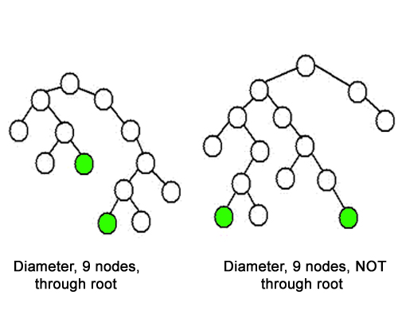
Diameter of a Binary Tree
Link: https://practice.geeksforgeeks.org/problems/diameter-of-binary-tree/1/

Slide 8
Diameter of a Binary Tree
Link: https://practice.geeksforgeeks.org/problems/diameter-of-binary-tree/1/

Slide 9
Diameter of a Binary Tree - Optimized
Link: https://practice.geeksforgeeks.org/problems/diameter-of-binary-tree/1/

Slide 10
Check if a tree is BST
Link: https://practice.geeksforgeeks.org/problems/check-for-bst/1

Slide 11
Check if a tree is BST
Link: https://practice.geeksforgeeks.org/problems/check-for-bst/1

Slide 12
Check if a tree is BST
Link: https://practice.geeksforgeeks.org/problems/check-for-bst/1

Slide 13
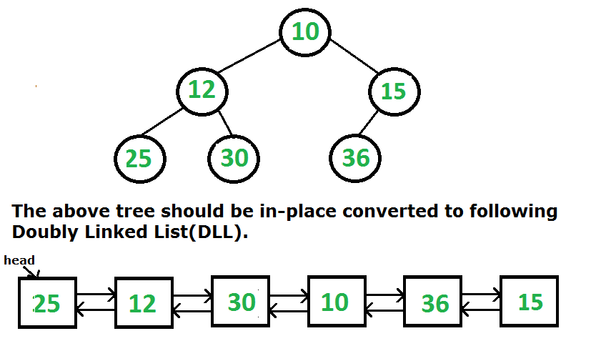
Binary Tree to Doubly Linked List
Link: https://practice.geeksforgeeks.org/problems/binary-tree-to-dll/1/
Ques. Convert a BST to a Sorted Doubly Linked List.
It is same as this ques because InOrder of a BST is sorted.

Slide 14
THANK YOU

